Slide 1
An Architecture for YANG-Push to Message Broker Integration draft-ietf-nmop-yang-message-broker-integration
Motivation and architecture of a native
YANG-Push notifications and YANG Schema integration
into Message Broker and YANG Schema Registry
ahmed.elhassany@swisscom.com thomas.graf@swisscom.com
1. November 2025

Slide 2
IETF YANG-Push A 22 years journey
IAB Workshop
Defines operators' requirements in RFC 3535 to lifecycle CLI and SNMP. YANG, Netconf and Restconf development started.
YANG 1.0
Specified in RFC 6020. 1.1 in RFC 7950.
gNMI
gNMI was presented to IETF NETCONF and implementations started at major network vendors.
Data Mesh Integration
Vendor-specific implementations and IETF YANG-Push are hard to manage. New requirements emerged for integrating with the message broker and an automated data processing chain. New specifications are proposed to resolve these challenges.
2002
2010
2017
2022
2015
2019
2024
IETF YANG-Push Specification Started
Development of RFC 8639 and RFC 8641 started at IETF NETCONF.
IETF YANG-Push Specification Finished
Development of RFC 8639 and RFC 8641 concluded at IETF NETCONF without any major network vendor implementations.
IETF YANG-Push Major Implementations Started
Questions arise. Proposing a simplified IETF YANG-Push and an Agile Incremental Driven Development.

Slide 3
Handling Operational YANG Modelled Data State of the Union
Nowadays network operators are using machine and human readable YANG RFC 7950 to model their configurations and obtain YANG modelled data from their networks.
Network operators organize their data in a Data Mesh where a message broker such as Apache Kafka facilitates the exchange of messages among data processing components.
Today, subscribing to a YANG datastore, publishing a YANG modeled notifications message from the network and viewing the data in a time series database, manual labor is needed to perform data transformation to make a message broker and its data processing components with YANG notifications interoperable.
« Even though YANG is intented to ease data management, this promise has not yet been fulfilled for Network Telemetry RFC 9232 »

Slide 4
From YANG-Push to Network Analytics Aiming for an automated data processing pipeline
A network operator aims for:
An automated data processing pipeline which starts with YANG-Push, consolidates at Data Mesh and ends at Network Analytics.
Operational metrics where IETF defines the semantics.
Analytical metrics where network operators gain actionable insights.
We achieve this by integrating YANG-Push into Data Mesh to:
Produce metrics from networks with timestamps when network events were observed.
Hostname, publisher ID and sequence numbers help us to understand from where metrics were exported and measure its delay and loss.
Forward metrics unchanged from networks
Learn semantics from networks and validate messages.
Control semantic changes end to end.

Slide 5
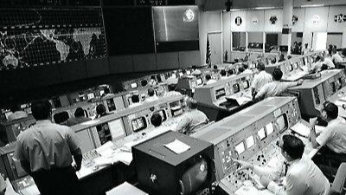
We have a dream Digital Twin at your fingertips
« Imagine that your entire life as network engineer you have logged into routers to perform show commands to get a glimpse into the current state of your networks. »
« Suddenly you see your colleague on the right querying the current network state in seconds directly from a real-time data stream. No access to routers needed. No databases needed. »
"NASA Mission Control Digital Twin in the 60s, Digital Twin is not Rocket Science"

Slide 6
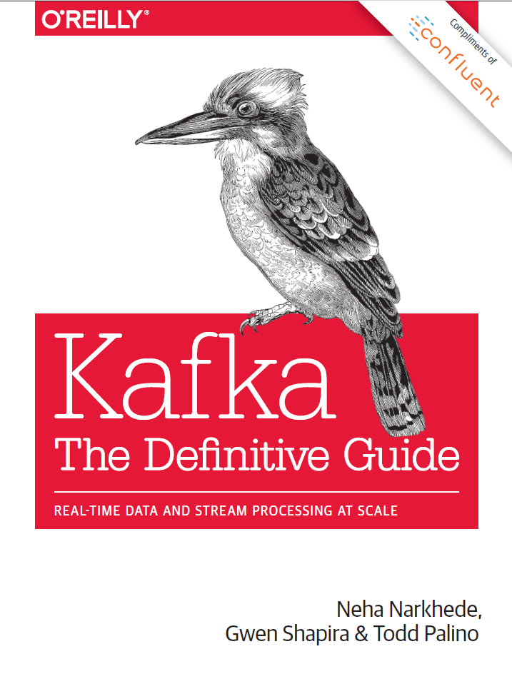
Terminology (1) Message Broker
Subject: A named communication channel where a schema registry assigned schema id is associated.
Topic: A communication channel for publishing and subscribing messages between producer and consumer with one or more subjects.
Topic Compaction: The act of compressing messages in a topic to the latest state.
Partition: Messages in a topic are spread over hash buckets where a hash bucket refers to a partition.
Message: A piece of structured data sent between data processing components to facilitate communication in a distributed system
Message Key: Metadata associated with a message to facilitate deterministic hash bucketing.
Segment: A physical file containing multiple messages.
https://www.confluent.io/thank-you/resources/ebook/kafka-the-definitive-guide/

Slide 7
Terminology (2) YANG Data Taxonomy and Index
module: ietf-interfaces
+--rw interfaces
+--rw interface* [name]
+--rw name string
+--rw description? string
+--rw type identityref
+--rw enabled? boolean
+--rw link-up-down-trap-enable? enumeration {if-mib}?
+--ro admin-status enumeration {if-mib}?
+--ro oper-status enumeration
+--ro last-change? yang:date-and-time
+--ro if-index int32 {if-mib}?
+--ro phys-address? yang:phys-address
+--ro higher-layer-if* interface-ref
+--ro lower-layer-if* interface-ref
+--ro speed? yang:gauge64
+--ro statistics
+--ro discontinuity-time yang:date-and-time
+--ro in-octets? yang:counter64
+--ro in-unicast-pkts? yang:counter64
+--ro in-broadcast-pkts? yang:counter64
+--ro in-multicast-pkts? yang:counter64
+--ro in-discards? yang:counter32
+--ro in-errors? yang:counter32
+--ro in-unknown-protos? yang:counter32
+--ro out-octets? yang:counter64
+--ro out-unicast-pkts? yang:counter64
+--ro out-broadcast-pkts? yang:counter64
+--ro out-multicast-pkts? yang:counter64
+--ro out-discards? yang:counter32
+--ro out-errors? yang:counter32
Dimensional Data: Structured information in a data store [Ralph Kimball]. Example: YANG with data taxonomy.
Data Taxonomy: Is a hierarchical system for classifying and organizing data into categories and subcategories
YANG Schema Tree: The definition hierarchy specified within a module.
YANG Schema Node: A node in the schema tree.
YANG Item Identifiers: Section 3.3 in RFC 9254 defines unique text-based identifiers for each YANG element including YANG schema nodes.
YANG index: Is a subset of YANG item identifiers containing only YANG schema node identifiers.

Slide 8
YANG-Push Discover and Subscribe to YANG metrics
From discovering YANG-Push subscription capabilities defined in RFC 9196, subscribing interesting metrics periodical (statistics), on-change (state changes) or on-change with sync-on-start (states) defined in RFC 8641.
Each subscription refers to network node, datastore (RFC 8342) and a schema tree.
In this RFC 8343 example ietf-interface statistics are subscribed periodically and ietf-interface states on-change sync-on-start. YANG-Push subscription ID's are per network node significant.
Data Collection obtains for each subscription the YANG schema tree by leveraging <get-schema> (RFC 6022), YANG Library (RFC 8525) and draft-ietf-netconf-yang-library-augmentedby.

Slide 9
YANG Schema Registry From 4 subscription ID's to 2 schema ID's
For all 4 YANG-Push subscriptions, YANG schema registration and comparison is performed.
Since the two YANG schema trees for both YANG-Push subscriptions are identical on both network nodes, two YANG globally unique schema ID's are being issued from the YANG schema registry to the YANG data producer.

Slide 10
Message Broker Topics, Subjects, Partitions, Segments and Message Keys
The YANG data producer creates for each YANG schema a new message broker topic, a message key and defines the number of partitions being used for the topic.
It serializes the message with the previously generated message key and message content according to draft-ietf-nmop-message-broker-telemetry-message.
Each message is prefixed with the previously obtained schema ID representing a unique message subject. The messages are distributed according to the hashed message key across the partitions into continuous segments.

Slide 11
YANG Data Consumption Discover and Subscribe to YANG metrics
A user or AI application/agent subscribes discovers through the stream catalog interesting metrics and subscribes to message broker topic.
More than one topic can be consumed at once by using a wildcard such as: project.enviroment.states.yang.* to consume all YANG state metrics.
The consumer hashes the message key and applies modulo with the number of partitions to determine the partition it needs to consume from to obtain messages with desired message key.

Slide 12
Fully YANG aware Data Pipeline From network nodes to message broker nodes
At the YANG data producer, thanks to the YANG awareness to the YANG data producer and the YANG schema registry, for each unique YANG schema tree a message broker topic and subject is being created, and messages are being indexed and hashed according to the message key.
At the message broker, thanks to the dedicated topic per YANG schema and its message key, YANG state metrics can be compacted to the latest state; reducing the number of stored messages.
At the YANG data consumer, thanks to the YANG awareness of the stream catalog and consumer, a specific topic, partition and subject can be consumed for the interested YANG metrics; reducing the number of messages to be consumed.

Slide 13

Addressing YANG Specification and Integration Gaps 9 documents at NMOP, NETCONF and NETMOD
YANG-Push Transport Gaps:
UDP-based Transport for Configured Subscriptions draft-ietf-netconf-udp-notif
Subscription to Distributed Notifications draft-ietf-netconf-distributed-notif
YANG-Push Specifications Gaps:
YANG Notification Transport Capabilities draft-ietf-netconf-yp-transport-capabilities
Extensible YANG model for YANG-Push Notifications draft-ietf-netconf-notif-envelope
Validating anydata in YANG Library context draft-netana-nmop-yang-anydata-validation
YANG-Push Integration Gaps and Arch:
Support of Versioning in YANG Notifications Subscription draft-ietf-netconf-yang-notifications-versioning
Augmented-by Addition into the IETF-YANG-Library draft-ietf-netconf-yang-library-augmentation
YANG-Push Simplification:
YANG-Push Operational Data Observability Enhancements draft-wilton-netconf-yp-observability
YANG-Push Message Broker:
An Architecture for YANG-Push to Message Broker Integration draft-ietf-nmop-yang-message-broker-integration
Extensible YANG Model for Network Telemetry Notifications draft-ietf-nmop-message-broker-telemetry-message
YANG Message Keys for Message Broker Integration draft-netana-nmop-yang-message-broker-message-key
Passed working group last call. Moving to IESG
Passed working group adoption call.
2025
2026
2027
2028

Slide 14
IETF YANG-Push Implementations Incremental development…
MVP 1 - Works
draft-ietf-netconf-udp-notif transport (with segmentation option) and notifications encoded in RFC 7951 IETF-JSON.
RFC 8641 periodic subscription with anchor-time configurable in ietf-subscribed-notifications.
YANG notifications as defined in draft-netana-netconf-notif-envelope, YANG module name, version and yang-library-content-id as in draft-ietf-netconf-yang-notifications-versioning and notification capabilities (RFC 9196) discoverable as defined in their documents.
YANG-Library as defined in RFC 8525 and draft-ietf-netconf-yang-library-augmentedby.
MVP 2 – Scales and Secures
Distributed notifications as defined in draft-ietf-netconf-distributed-notif.
YANG notifications encoded in CBOR (named identifiers) as defined in RFC 9254.
YANG notifications DTLS (1.2 MUST RFC 6347, 1.3 SHOULD RFC 9147) encrypted as defined in draft-ietf-netconf-udp-notif.
MVP 3 - Optimizes
RFC 8641 on-change subscription configurable in ietf-subscribed-notifications.
RFC 8641 on-change and periodical subscription in RFC 9196 defined capabilities discoverable.
draft-ietf-netconf-udp-notif transport, encoding and encryption capabilities (RFC 9196) discoverable with draft-ietf-netconf-yp-transport-capabilities.
4 major vendor implementations finalized.
2 major vendor implementations started.

Slide 15
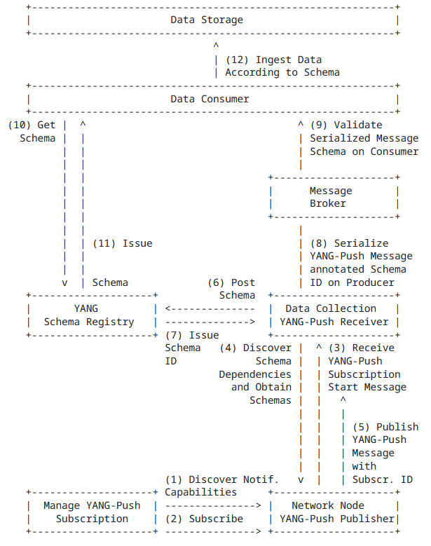
Part 2
Our collaboration goes into the next step in 2026
This allows Swisscom
to transition from SNMP to YANG
2025
2026
2027
2028

Slide 16

IETF YANG Model Implementations Incremental development…
"Starting 2026, Swisscom onboards new network platforms with YANG-Push only. Initiating the SNMP to YANG lifecycle and the standardization of YANG models."
MVP 2 – Physical & Essential
ietf-interfaces.yang (inventory, state and statistic)
ietf-hardware.yang (inventory, state and statistic)
ietf-alarms.yang (state)
ieee802-dot1ab-lldp.yang (inventory and state)
MVP 3 – Logical Relationships
ieee802-dot1ax.yang (inventory, state and statistic)
ietf-bfd-ip-sh.yang (state)
ietf-bfd-ip-mh.yang (state)
ietf-bfd-lag.yang (state)
ietf-isis.yang (state)
Already supported by OLT MA5800.

Slide 17
RFC 8343 – ietf-interfaces.yang YANG Data Model for Interface Management
module: ietf-interfaces
+--rw interfaces
+--rw interface* [name]
+--rw name string
+--rw description? string
+--rw type identityref
+--rw enabled? boolean
+--rw link-up-down-trap-enable? enumeration {if-mib}?
+--ro admin-status enumeration {if-mib}?
+--ro oper-status enumeration
+--ro last-change? yang:date-and-time
+--ro if-index int32 {if-mib}?
+--ro phys-address? yang:phys-address
+--ro higher-layer-if* interface-ref
+--ro lower-layer-if* interface-ref
+--ro speed? yang:gauge64
+--ro statistics
+--ro discontinuity-time yang:date-and-time
+--ro in-octets? yang:counter64
+--ro in-unicast-pkts? yang:counter64
+--ro in-broadcast-pkts? yang:counter64
+--ro in-multicast-pkts? yang:counter64
+--ro in-discards? yang:counter32
+--ro in-errors? yang:counter32
+--ro in-unknown-protos? yang:counter32
+--ro out-octets? yang:counter64
+--ro out-unicast-pkts? yang:counter64
+--ro out-broadcast-pkts? yang:counter64
+--ro out-multicast-pkts? yang:counter64
+--ro out-discards? yang:counter32
+--ro out-errors? yang:counter32
With IETF YANG-Push we like to subscribe
with on-change sync-on-start
For inventory and alert use cases the state of the interface.
and periodically
For performance measurement use cases the interface statistics.

Slide 18
RFC 8348 – ietf-hardware.yang YANG Data Model for Hardware Management
module: ietf-hardware
+--rw hardware
+--ro last-change? yang:date-and-time
+--rw component* [name]
+--rw name string
+--rw class identityref
+--ro physical-index? int32 {entity-mib}?
+--ro description? string
+--rw parent? -> ../../component/name
+--rw parent-rel-pos? int32
+--ro contains-child* -> ../../component/name
+--ro hardware-rev? string
+--ro firmware-rev? string
+--ro software-rev? string
+--ro serial-num? string
+--ro mfg-name? string
+--ro model-name? string
+--rw alias? string
+--rw asset-id? string
+--ro is-fru? boolean
+--ro mfg-date? yang:date-and-time
+--rw uri* inet:uri
+--ro uuid? yang:uuid
+--rw state {hardware-state}?
| +--ro state-last-changed? yang:date-and-time
| +--rw admin-state? admin-state
| +--ro oper-state? oper-state
| +--ro usage-state? usage-state
| +--ro alarm-state? alarm-state
| +--ro standby-state? standby-state
+--ro sensor-data {hardware-sensor}?
+--ro value? sensor-value
+--ro value-type? sensor-value-type
+--ro value-scale? sensor-value-scale
+--ro value-precision? sensor-value-precision
+--ro oper-status? sensor-status
+--ro units-display? string
+--ro value-timestamp? yang:date-and-time
+--ro value-update-rate? uint32
With IETF YANG-Push we like to subscribe
with on-change sync-on-start
For inventory use cases the state of the hardware.
For alert use cases the hardware state change notifications.
and periodically
For performance measurement use cases the hardware sensor-data.
notifications:
+---n hardware-state-change
+---n hardware-state-oper-enabled {hardware-state}?
| +--ro name? -> /hardware/component/name
| +--ro admin-state? -> /hardware/component/state/admin-state
| +--ro alarm-state? -> /hardware/component/state/alarm-state
+---n hardware-state-oper-disabled {hardware-state}?
+--ro name? -> /hardware/component/name
+--ro admin-state? -> /hardware/component/state/admin-state
+--ro alarm-state? -> /hardware/component/state/alarm-state

Slide 19
RFC 8632 – ietf-alarms.yang YANG Data Model for Alarm Management
notifications:
+---n alarm-notification
| +--ro resource resource
| +--ro alarm-type-id alarm-type-id
| +--ro alarm-type-qualifier? alarm-type-qualifier
| +--ro alt-resource* resource
| +--ro related-alarm* [resource alarm-type-id alarm-type-qualifier] {alarm-correlation}?
| | +--ro resource -> /alarms/alarm-list/alarm/resource
| | +--ro alarm-type-id -> /alarms/alarm-list/alarm[resource=current()/../resource]/alarm-type-id
| | +--ro alarm-type-qualifier -> /alarms/alarm-list/alarm[resource=current()/../resource][alarm-type-id=current()/../alarm-type-id]/alarm-type-qualifier
| +--ro impacted-resource* resource {service-impact-analysis}?
| +--ro root-cause-resource* resource {root-cause-analysis}?
| +--ro time yang:date-and-time
| +--ro perceived-severity severity-with-clear
| +--ro alarm-text alarm-text
+---n alarm-inventory-changed
With IETF YANG-Push we like to subscribe
with on-change
For alert use cases the alarm notifications.

Slide 20
IEEE LLDP – ieee802-dot1ab-lldp.yang YANG Data Model for LLDP Neighbor Discovery
module: ieee802-dot1ab-lldp
+--rw lldp
+--ro local-system-data
| +--ro chassis-id-subtype? ieee:chassis-id-subtype-type
| +--ro chassis-id? ieee:chassis-id-type
| +--ro system-name? string
| +--ro system-description? string
| +--ro system-capabilities-supported? lldp-types:system-capabilities-map
| +--ro system-capabilities-enabled? lldp-types:system-capabilities-map
+--rw port* [name dest-mac-address]
+--rw name if:interface-ref
+--rw dest-mac-address ieee:mac-address
+--ro port-id? ieee:port-id-type
+--ro remote-systems-data* [time-mark remote-index]
+--ro time-mark yang:timeticks
+--ro remote-index uint32
+--ro remote-too-many-neighbors? boolean
+--ro remote-changes? boolean
+--ro chassis-id-subtype? ieee:chassis-id-subtype-type
+--ro chassis-id? ieee:chassis-id-type
+--ro port-id-subtype? ieee:port-id-subtype-type
+--ro port-id? ieee:port-id-type
+--ro port-desc? string
+--ro system-name? string
+--ro system-description? string
+--ro system-capabilities-supported? lldp-types:system-capabilities-map
+--ro system-capabilities-enabled? lldp-types:system-capabilities-map
With IETF YANG-Push we like to subscribe
with on-change sync-on-start
For inventory use cases the local and remote-systems-data.

Slide 21
IEEE dot1ax – ieee802-dot1ax.yang YANG Data Model for LAG Interface Management
module: ieee802-dot1ax
+--rw lag-system
+--rw aggregating-system* [agg-system]
+--rw agg-system string
+--rw system-id? ieee:mac-address
+--rw system-priority? uint32
augment /if:interfaces/if:interface:
+--rw aggregator
+--rw name? string
+--rw agg-system-name? string
+--rw admin-state? enumeration
+--rw link-up-down-notification? enumeration
+--rw collector-max-delay? int16
+--rw aggregator-lacp
+--rw actor-admin-key? int16
augment /if:interfaces/if:interface:
+--rw aggregation-port
+--rw aggregation-port-lacp
+--rw actor-system-priority? int16
+--rw actor-admin-key? int16
+--rw partner-admin-system-priority? int16
+--rw partner-admin-system-id? ieee:mac-address
+--rw partner-admin-key? int16
+--rw actor-port-priority? int16
+--rw partner-admin-port? int16
+--rw partner-admin-port-priority? int16
+--rw actor-admin-state? bits
+--rw partner-admin-state? bits
With IETF YANG-Push we like to subscribe
with on-change sync-on-start
For inventory use cases the state of the hardware.

Slide 22
RFC 9127 – ietf-bfd.yang YANG Data Model for Bidirectional Forwarding Detection
BFD IP Single-Hop Hierarchy
https://datatracker.ietf.org/doc/html/rfc9127#section-2.6
notifications:
+---n singlehop-notification
+--ro local-discr? discriminator
+--ro remote-discr? discriminator
+--ro new-state? state
+--ro state-change-reason? iana-bfd-types:diagnostic
+--ro time-of-last-state-change? yang:date-and-time
+--ro dest-addr? inet:ip-address
+--ro source-addr? inet:ip-address
+--ro session-index? uint32
+--ro path-type? identityref
+--ro interface? if:interface-ref
+--ro echo-enabled? boolean
BFD-over-LAG Hierarchy
https://datatracker.ietf.org/doc/html/rfc9127#section-2
notifications:
+---n lag-notification
+--ro local-discr? discriminator
+--ro remote-discr? discriminator
+--ro new-state? state
+--ro state-change-reason? iana-bfd-types:diagnostic
+--ro time-of-last-state-change? yang:date-and-time
+--ro dest-addr? inet:ip-address
+--ro source-addr? inet:ip-address
+--ro session-index? uint32
+--ro path-type? identityref
+--ro lag-name? if:interface-ref
+--ro member-link? if:interface-ref
With IETF YANG-Push we like to subscribe
with on-change sync-on-start
For alert use cases the hardware state notifications.
BFD IP Multihop Hierarchy
https://datatracker.ietf.org/doc/html/rfc9127#section-2.7
notifications:
+---n multihop-notification
+--ro local-discr? discriminator
+--ro remote-discr? discriminator
+--ro new-state? state
+--ro state-change-reason? iana-bfd-types:diagnostic
+--ro time-of-last-state-change? yang:date-and-time
+--ro dest-addr? inet:ip-address
+--ro source-addr? inet:ip-address
+--ro session-index? uint32
+--ro path-type? identityref

Slide 23
RFC 9130 – ietf-isis.yang YANG Data Model for the IS-IS Protocol
notifications:
+---n database-overload
| +--ro routing-protocol-name? -> /rt:routing/
| | control-plane-protocols/
| | control-plane-protocol/name
| +--ro isis-level? level
| +--ro overload? enumeration
+---n if-state-change
| +--ro routing-protocol-name? -> /rt:routing/
| | control-plane-protocols/
| | control-plane-protocol/name
| +--ro isis-level? level
| +--ro interface-name? if:interface-ref
| +--ro interface-level? level
| +--ro extended-circuit-id? extended-circuit-id
| +--ro state? if-state-type
+---n adjacency-state-change
| +--ro routing-protocol-name? -> /rt:routing/
| | control-plane-protocols/
| | control-plane-protocol/name
| +--ro isis-level? level
| +--ro interface-name? if:interface-ref
| +--ro interface-level? level
| +--ro extended-circuit-id? extended-circuit-id
| +--ro neighbor? string
| +--ro neighbor-system-id? system-id
| +--ro state? adj-state-type
| +--ro reason? string
With IETF YANG-Push we like to subscribe
with on-change sync-on-start
For alert use cases the hardware state notifications.

Slide 24
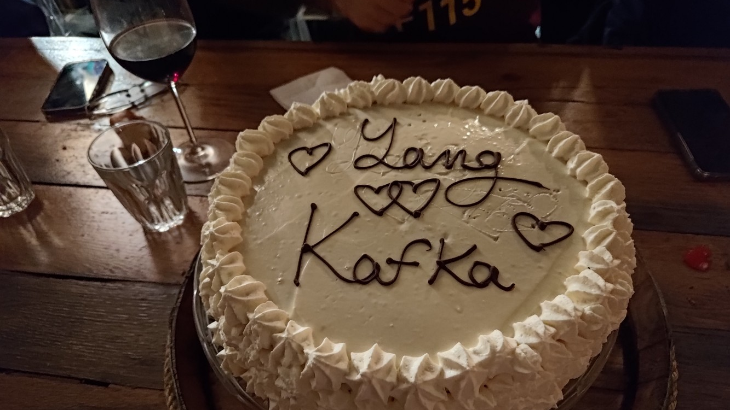

Slide 25

Validate Configured Subscription YANG-Push Publisher Implementations IETF 123 Hackathon, July 19-20th 2025
NMOP & NETCONF WG

Slide 26

IETF 123 Hackathon Test and Development Plan and Software
Test Plan
Subscription automation
Discover YANG-Push systems and notifications capabilities and configure periodical and on-change subscriptions with netconf.
Notification integration
Validate subscription state change and push-update and push-change-update notifications against schema with yanglint
Validate draft-ietf-nmop-message-broker-telemetry-message for draft-ietf-nmop-yang-message-broker-integration integration
Development Plan
MVP 1 – Basic Requirements (9)
MVP 2 – Scale and Secure (3)
MVP 3 – Optimizations (2)
Software
YANG-Push Publisher - Cisco IOS XR
YANG-Push Publisher - 6WIND VSR
YANG-Push Publisher - Huawei NE (Router) and MA (OLT)
YANG-Push Receiver – Netgauze
udp-notif dissector - Wireshark
NMOP & NETCONF WG
https://www.network-analytics.org/yp/how-to-deploy.html

Slide 27
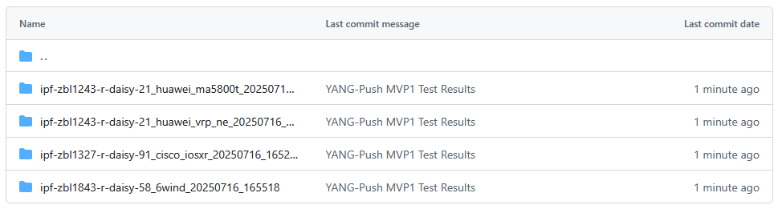
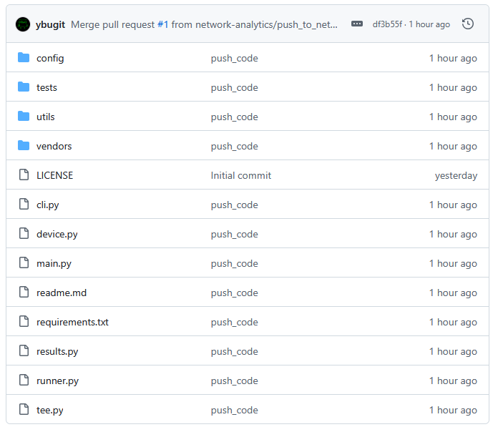
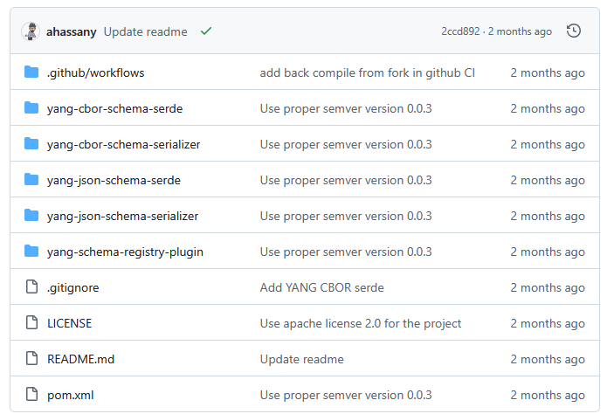
IETF 123 Hackathon Repositories
Test Result Repository
https://github.com/network-analytics/ietf-network-analytics-document-status/tree/main/123/Hackathon
Packet capture on the wire
Netconf RPCs and YANG-Push JSON and CBOR encoded messages
Test Tool Repository
https://github.com/network-analytics/yp_test
YANG-Push Test Automation Tool
Vendor deviations configuration
Apache Kafka Integration
https://github.com/network-analytics/yang-kafka-integration
YANG Serializer
YANG Schema Registry Plugin
NMOP & NETCONF WG

Slide 28

YANG-Push Implementation Status IETF 123 – MVP 1
 | 6WIND VSR | Huawei NE | Huawei MA | Cisco IOS XR | Open-Source
RFC 8639 YANG-Push Subscription | ✔ | ✔ | ✔ | ✔
RFC 8641 YANG-Push Notification | ✔ | P | ✔ | ✔
draft-ietf-netconf-udp-notif | ✔ | ✔ | ✔ | ✔ | ✔
draft-ietf-netconf-yang-notifications-versioning | ✔ | ✔ | ✔ | ✔
draft-tgraf-netconf-notif-sequencing | ✔ | ✔ | ✔ | ✔
draft-tgraf-netconf-yang-push-observation-time | ✔ | ✔ | ✔ | ✔
RFC 8525 YANG Library | ✔ | ✔ | ✔ | ✔
draft-ietf-netconf-yang-library-augmentation | ✔ | ✔ | ✔ | ✔ | ✔
RFC 9196 System and Notification Capabilities |  |  | ✔ | P
draft-ietf-netconf-notif-envelope | ✔ | ✔ | ✔ | ✔
NetGauze
Pmacct
udp-notif-c-collector
yang-library-augmentedby
Green marked describes new capability at IETF 123. "P" to partially implemented.

Slide 29
YANG-Push Subscription Started
{
"ietf-yp-notification:envelope": {
"event-time": "2025-05-27T11:32:09.530+01:00",
"hostname": "ipd-zbl1536-s-ah-79",
"sequence-number": 0,
"notification-contents": {
"ietf-subscribed-notifications:subscription-started": {
"id": 1,
"ietf-yang-push:datastore": "ietf-datastores:operational",
"ietf-yang-push:datastore-xpath-filter": "/ietf-interfaces:interfaces/interface[type='iana-if-type:ethernetCsmacd']/statistics",
"dscp": 0,
"transport": "ietf-udp-notif-transport:udp-notif",
"encoding": "ietf-subscribed-notifications:encode-json",
"ietf-yang-push:periodic": {
"period": 6000
},
"ietf-yang-push-revision:module-version": [
{
"module-name": "iana-if-type",
"revision": "2017-01-19",
"revision-label": ""
},
YANG Schema Tree
module: bbf-hardware-cpu
augment /ietf-hardware:hardware/ietf-hardware:component:
+--ro cpu-processor-data
+--ro cpu-usage
| +--ro cpu-core-processes? bbf-yang-types:percent
| +--ro cpu-user? bbf-yang-types:percent
| +--ro cpu-idle? bbf-yang-types:percent
| +--ro cpu-hwio? bbf-yang-types:percent
| +--ro cpu-io? bbf-yang-types:percent
| +--ro cpu-nice? bbf-yang-types:percent
| +--ro cpu-swint? bbf-yang-types:percent
+--ro memory-usage
+--ro used-mem? uint64
+--ro total-memory? uint64
+--ro free-memory? uint64
+--ro buffer-memory? uint64
+--ro total-swap-memory? uint64
+--ro used-swap? uint64
+--ro free-swap? uint64
+--ro available-mem? uint64
Huawei VRP
YANG-Push Push Update
{
"ietf-yp-notification:envelope": {
"event-time": "2025-05-27T10:37:10.180+01:00",
"hostname": "ipd-zbl1536-s-ah-79",
"sequence-number": 0,
"notification-contents": {
"ietf-yang-push:push-update": {
"id": 16,
"ietf-yp-observation:timestamp": "2025-05-27T10:37:10.180+01:00",
"ietf-yp-observation:point-in-time": "current-accounting",
"ietf-distributed-notif:message-publisher-id": 3021116849,
"datastore-contents": {
"ietf-hardware:hardware": {
"component": [
{
"name": "cpu.0.2",
"class": "iana-hardware:cpu",
"bbf-hardware-cpu:cpu-processor-data": {
"cpu-usage": {
"cpu-idle": 86
},
"memory-usage": {
"total-memory": "1409024",
"free-memory": "1067745"
}
YANG Semantics
container memory-usage {
description
"Statistics associated with memory utilization.";
leaf total-memory {
type uint64;
units "kibibytes";
description
"The total amount of memory in kibibytes.";
}
leaf free-memory {
type uint64;
units "kibibytes";
description
"Total free memory in kibibytes.";
}

Slide 30
YANG Schema Tree
module: openconfig-lacp
+--rw lacp
+--rw config
| +--rw system-priority? uint16
+--ro state
| +--ro system-priority? uint16
+--rw interfaces
+--rw interface* [name]
+--rw name -> ../config/name
+--rw config
| +--rw name? oc-if:base-interface-ref
| +--rw interval? lacp-period-type
| +--rw lacp-mode? lacp-activity-type
| +--rw system-id-mac? oc-yang:mac-address
| +--rw system-priority? uint16
+--ro state
| +--ro name? oc-if:base-interface-ref
| +--ro interval? lacp-period-type
| +--ro lacp-mode? lacp-activity-type
| +--ro system-id-mac? oc-yang:mac-address
| +--ro system-priority? uint16
YANG-Push Subscription Started
{
"ietf-yp-notification:envelope": {
"event-time": "2025-06-17T07:33:46.061Z",
"hostname": "ipf-zbl1327-r-daisy-91",
"sequence-number": 0,
"contents": {
"ietf-subscribed-notifications:subscription-started": {
"id": 17,
"ietf-yang-push:datastore": "operational",
"ietf-yang-push:datastore-xpath-filter": "openconfig-lacp:lacp/state",
"transport": "ietf-udp-notif-transport:udp-notif",
"ietf-yang-push-revision:module-version": [
{
"module-name": "openconfig-lacp",
"revision": "2023-12-11"
}
],
"ietf-yang-push-revision:yang-library-content-id": "4df70b4158a31ba6334f11b7bc2d41e6bbc0f16b",
"encoding": "encode-json",
"ietf-yang-push:on-change": {
"sync-on-start": true
}
Cisco IOS XR
YANG Semantics
grouping aggregation-lacp-global-config {
description
"Configuration data for LACP aggregate interfaces";
leaf system-priority {
type uint16;
description
"Sytem priority used by the node on this LAG interface.
Lower value is higher priority for determining which node
is the controlling system.";
}
}
YANG-Push Push Update
{
"ietf-yp-notification:envelope": {
"event-time": "2025-06-17T07:33:48.741Z",
"hostname": "ipf-zbl1327-r-daisy-91",
"sequence-number": 1,
"contents": {
"ietf-yang-push:push-update": {
"id": 17,
"ietf-yp-observation:timestamp": "2025-06-17T07:33:48.741Z",
"ietf-yp-observation:point-in-time": "initial-state",
"datastore-contents": {
"openconfig-lacp:lacp": {
"state": {
"system-priority": 32768
}

Slide 31
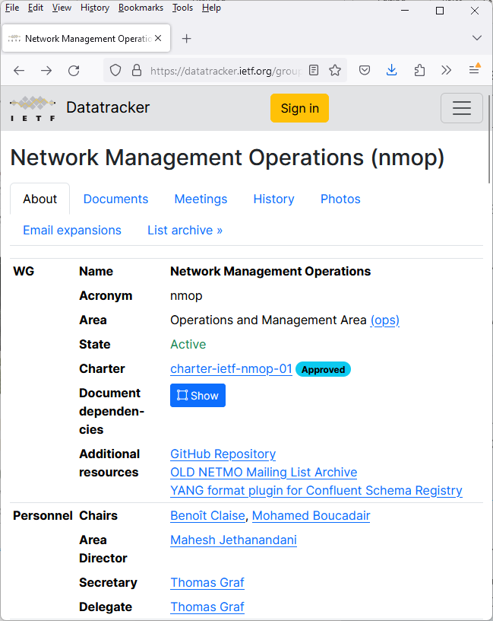


IETF NMOP 123 – Network Observability Development Network Anomaly Detection and YANG-Push/Message Broker Integration
https://datatracker.ietf.org/group/nmop/about/
https://www.linkedin.com/pulse/network-analytics-ietf-123-madrid-thomas-graf-jjzge/

Slide 32
Extensible YANG model for YANG-Push Notifications For XML, JSON or CBOR encoded messages with hostname, sequence-number and observation-time
notifications:
+---n envelope
+--ro event-time yang:date-and-time
+--ro hostname? inet:host
| {notification-hostname-sequence-number}?
+--ro sequence-number? yang:counter32
| {notification-hostname-sequence-number}?
+--ro notification-contents? <anydata>
module: ietf-yp-observation-time
augment /yp:push-update:
+--ro observation-time? yang:date-and-time
+--ro point-in-time? enumeration
augment /yp:push-change-update:
+--ro observation-time? yang:date-and-time
+--ro point-in-time? enumeration
augment /sysc:system-capabilities/notc:subscription-capabilities:
+--ro yang-push-observation-supported?
inotifseq:notification-support
{yang-push-observation-timestamp}?
draft-ietf-netconf-notif-envelope defines new extensible notification structure, defined in YANG, for use in YANG-Push Notification messages enabling any YANG compatible encodings such as XML RFC 7950, JSON RFC 7951 or CBOR RFC 9264.
New notification envelope can be enabled in "ietf-subscribed-notification" RFC 8639.
Capability can be discovered through 'ietf-notification-capabilities' RFC 9196.
Supports the following notification metadata extensions
hostname: Describes the node's hostname according to the 'sysName' object definition in RFC 1213 from where the message was published from. This value is usually configured on the node by the administrator to uniquely identify the node in the network.
sequence-number: Generates a unique sequence number for each published message by the publisher process. The number counts up at every published notification message as described in RFC 9187.
observation-time: Describes the measurement observation time for the "push-update" notification in a "periodical" and for the "push-change-update" notification in a "on-change" subscription.
point-in-time: Describes at which point in time the value of observation-time was observed.
{
"ietf-yp-notification:envelope": {
"event-time": "2023-03-25T08:30:11.22Z",
"hostname": "example-router",
"sequence-number": 1,
"notification-contents": {
"ietf-yang-push:push-update": {
"id": 6666,
"ietf-yp-observation-time:observation-time": "2023-02-04T16:30:09.44Z",
"ietf-yp-observation-time:point-in-time": "current-accounting",
"datastore-contents": {
"ietf-interfaces:interfaces": [
{
"interface": {
"name": "eth0",
"type": "iana-if-type:ethernetCsmacd",
"oper-status": "up",
"mtu": 1500

Slide 33
Support of Versioning in YANG Notifications Subscription For subscription state change notification messages
module: ietf-yang-push-revision
augment /sn:establish-subscription/sn:input:
+---w module-version-config* [module-name]
+---w module-name yang:yang-identifier
+---w revision? rev:revision-date-or-label
+---w revision-label? ysver:version
augment /sn:subscription-started:
+--ro module-version* [module-name]
| {yang-push-revision-supported}?
| +--ro module-name yang:yang-identifier
| +--ro revision rev:revision-date
| +--ro revision-label? ysver:version
+--ro yang-library-content-id? -> /yanglib:yang-library/content-id
{yang-push-revision-supported}?
Network operators need to control semantics in its data processing pipeline. That includes YANG-Push.
This is today only possible during YANG-Push subscription but not when nodes are being upgraded or when messages are being published for configured subscription.
draft-ietf-netconf-yang-notifications-versioning extends the YANG push subscription and publishing mechanism defined in RFC 8641:
By adding the ability to subscribe to a specific revision or latest-compatible-semversion of one or more yang modules.
By extending the YANG push Subscription State Change Notifications Message so that the YANG push receiver learns beside the xpath and the sub-tree filter also the yang module name, revision, revision-label and the yang-library-content-id. With YANG Library content-id a YANG-Push receiver is now able to detect changes in the YANG library. This includes also the imported YANG modules of the subscribed xpath.
Extends RFC 9196 defined subscription-capabilities with a yang-push-module-revision-supported leaf.
{
"ietf-notification:notification": {
"eventTime": "2023-03-25T08:30:11.22Z",
"ietf-notification-sequencing:sysName": "example-router",
"ietf-notification-sequencing:sequenceNumber": 1,
"ietf-subscribed-notification:subscription-started": {
"id": 6666,
"ietf-yang-push:datastore": "ietf-datastores:operational",
"ietf-yang-push:datastore-xpath-filter": "/if:interfaces",
"ietf-yang-push-revision:revision": "2014-05-08",
"ietf-yang-push-revision:module-name": "ietf-interfaces",
"ietf-yang-push-revision:revision-label": "",,
"ietf-yang-push-revision:yang-library-content-id": "1",
"ietf-distributed-notif:message-observation-domain-id": [1,2],
"transport": "ietf-udp-notif-transport:udp-notif",
"encoding": "encode-json",
"ietf-yang-push:periodic": {
"ietf-yang-push:period": 100
}
}
}
}

Slide 34
YANG Notification Transport Capabilities Extending System Capabilities for YANG-Push Configured Subscription Transport
module: ietf-notification-transport-capabilities
augment /sysc:system-capabilities/notc:subscription-capabilities:
+--ro transport-capabilities
+--ro transport-capability* [transport-protocol]
+--ro transport-protocol identityref
+--ro security-protocol? identityref
+--ro encoding-format* identityref
augment "/sysc:system-capabilities/notc:subscription-capabilities" {
description "Add system level capability.";
container transport-capabilities {
description "Capabilities related to YANG-Push transports.";
list transport-capability {
key "transport-protocol";
description "Capability list related to notification transport capabilities.";
leaf transport-protocol {
type identityref {
base sn:transport;
}
description "Supported transport protocol for YANG-Push.";
}
leaf security-protocol {
type identityref {
base security-protocol;
}
description "Type of secure transport.";
}
leaf-list encoding-format {
type identityref {
base sn:encoding;
}
description "Supported encoding formats.";
}
}
}
draft-ietf-netconf-yp-transport-capabilities augments System Capabilities model and provides additional transport related attributes associated with system capabilities:
Specification of transport protocols the client can request to establish a draft-ietf-netconf-udp-notif or draft-ietf-netconf-https-notif configured transport connection;
Specification of transport encoding, such as JSON or XML as defined in RFC 8040 or CBOR as defined in RFC 9254 the client can request to encode YANG notifications;
Specification of secure transport mechanisms that are needed by the client to communicate with the server such as DTLS as defined in RFC 9147 TLS as defined in RFC 8446 or SSH as defined in RFC 4254;

Slide 35
Augmented-by Addition YANG Library Extension
module: ietf-yang-library
+--ro yang-library
| +--ro module-set* [name]
| | +--ro name string
| | +--ro module* [name]
| | | +--ro name yang:yang-identifier
| | | +--ro revision? revision-identifier
| | | +--ro namespace inet:uri
| | | +--ro location* inet:uri
| | | +--ro submodule* [name]
| | | | +--ro name yang:yang-identifier
| | | | +--ro revision? revision-identifier
| | | | +--ro location* inet:uri
| | | +--ro feature* yang:yang-identifier
| | | +--ro deviation* -> ../../module/name
| | | +--ro yanglib-aug:augmented-by*
-> ../../yanglib:module/name
With YANG-Push xpath or sub-tree a part of the YANG-Push data tree is subscribed.
With YANG Library the relationship among the subscribed YANG modules can be determined from the top of the YANG tree. What is missing is the ability to discover dependencies within the YANG tree.
draft-ietf-netconf-yang-library-augmentedby extends the YANG library defined in RFC 8525:
By adding augmented-by YANG module relation.

Slide 36
Validate anydata schema subtree with YANG Library RFC 7950 Extension
notifications:
+---n push-update
| +--ro id? sn:subscription-id
| +--ro datastore-contents? <anydata>
With YANG-Push xpath or sub-tree a part of the YANG-Push data tree is subscribed. The subscribed YANG datastore content is published as anydata, event though the content has a valid schema.
RFC 7950 lacks specification how the data model of anydata content is exposed through YANG library defined in RFC 8525.
draft-aelhassany-anydata-validation extends RFC 7950 by describing:
How anydata can be validated with YANG Library.
{
"ietf-yang-push:push-update": {
"id": 89,
"datastore-contents": {
"ietf-interfaces:interfaces": {
"interface": [
{
"name": "eth0",
"oper-status": "down"
}]
}}
}
}
RFC 7950
7.10. The "anydata" Statement
The "anydata" statement defines an interior node in the schema
tree. It takes one argument, which is an identifier, followed by
a block of substatements that holds detailed anydata information.
The "anydata" statement is used to represent an unknown set of
nodes that can be modeled with YANG, except anyxml, but for which
the data model is not known at module design time. It is
possible, though not required, for the data model for anydata
content to become known through protocol signaling or other means
that are outside the scope of this document.

Slide 37
YANG-Push Operational Data Observability Enhancements Simplifies by combining periodic and on-change subscription
module: ietf-yp-ext
augment /sn:subscription-started/yp:update-trigger:
+--:(periodic-and-on-change) {yp:on-change}?
+-- periodic-and-on-change!
+-- period yp:centiseconds
+-- anchor-time? yang:date-and-time
+-- dampening-period? yp:centiseconds
+-- sync-on-start? boolean
+-- excluded-change* yp:change-type
augment /sn:subscription-started:
+--ro common-notification-format? boolean
augment /sn:subscription-modified/yp:update-trigger:
+--:(periodic-and-on-change) {yp:on-change}?
+-- periodic-and-on-change!
+-- period yp:centiseconds
+-- anchor-time? yang:date-and-time
+-- dampening-period? yp:centiseconds
+-- sync-on-start? boolean
+-- excluded-change* yp:change-type
augment /sn:subscription-modified:
+--ro common-notification-format? boolean
augment /sn:subscriptions/sn:subscription/yp:update-trigger:
+--:(periodic-and-on-change) {yp:on-change}?
+--rw periodic-and-on-change!
+--rw period yp:centiseconds
+--rw anchor-time? yang:date-and-time
+--rw dampening-period? yp:centiseconds
+--rw sync-on-start? boolean
+--rw excluded-change* yp:change-type
augment /sn:subscriptions/sn:subscription:
+--rw common-notification-format? boolean
To reduce complexities in modelling the operational state, the following two YANG-Push enhancements are proposed:
A new YANG-Push encoding format that can be used for both on-change and periodic subscriptions that reports the data from the subscription filter point.
A combined periodic and on-change subscription that reports events on a periodical cadence and also if changes to the data have occurred.
This removes the YANG Patch format RFC 8072 dependency and eases the message broker integration.
Allows the YANG-Push publisher to split a subscription into smaller child subscriptions for more efficient independent and concurrent processing. Reuses the ideas from draft-ietf-netconf-distributed-notif. Child subscriptions remain encoded from the same subscription point.
notifications:
+---n update
+--ro id? sn:subscription-id
+--ro subscription-path? yang:xpath1.0
+--ro target-path? string
+--ro snapshot-type? enumeration
+--ro observation-time? yang:date-and-time
+--ro datastore-snapshot? <anydata>
+--ro incomplete? empty

Slide 38
RFC 8343 – ietf-interfaces.yang vs. openconfig-interfaces.yang YANG Data Model for Interface Management
module: ietf-interfaces
+--rw interfaces
+--rw interface* [name]
+--rw name string
+--rw description? string
+--rw type identityref
+--rw enabled? boolean
+--rw link-up-down-trap-enable? enumeration {if-mib}?
+--ro admin-status enumeration {if-mib}?
+--ro oper-status enumeration
+--ro last-change? yang:date-and-time
+--ro if-index int32 {if-mib}?
+--ro phys-address? yang:phys-address
+--ro higher-layer-if* interface-ref
+--ro lower-layer-if* interface-ref
+--ro speed? yang:gauge64
+--ro statistics
+--ro discontinuity-time yang:date-and-time
+--ro in-octets? yang:counter64
+--ro in-unicast-pkts? yang:counter64
+--ro in-broadcast-pkts? yang:counter64
+--ro in-multicast-pkts? yang:counter64
+--ro in-discards? yang:counter32
+--ro in-errors? yang:counter32
+--ro in-unknown-protos? yang:counter32
+--ro out-octets? yang:counter64
+--ro out-unicast-pkts? yang:counter64
+--ro out-broadcast-pkts? yang:counter64
+--ro out-multicast-pkts? yang:counter64
+--ro out-discards? yang:counter32
+--ro out-errors? yang:counter32
module: openconfig-interfaces
+--rw interfaces
+--rw interface* [name]
+--rw subinterfaces
+--rw subinterface* [index]
+--rw index -> ../config/index
+--rw config
| +--rw index? uint32
| +--rw description? string
| +--rw enabled? boolean
+--ro state
+--ro index? uint32
+--ro description? string
+--ro enabled? boolean
+--ro name? string
+--ro ifindex? uint32
+--ro admin-status enumeration
+--ro oper-status enumeration
+--ro last-change? oc-types:timeticks64
+--ro logical? boolean
+--ro management? boolean
+--ro cpu? boolean
+--ro counters
+--ro in-octets? oc-yang:counter64
+--ro in-pkts? oc-yang:counter64
+--ro in-unicast-pkts? oc-yang:counter64
+--ro in-broadcast-pkts? oc-yang:counter64
+--ro in-multicast-pkts? oc-yang:counter64
+--ro in-discards? oc-yang:counter64
+--ro in-errors? oc-yang:counter64
+--ro in-unknown-protos? oc-yang:counter64
+--ro in-fcs-errors? oc-yang:counter64
+--ro out-octets? oc-yang:counter64
+--ro out-pkts? oc-yang:counter64
+--ro out-unicast-pkts? oc-yang:counter64
+--ro out-broadcast-pkts? oc-yang:counter64
+--ro out-multicast-pkts? oc-yang:counter64
+--ro out-discards? oc-yang:counter64
+--ro out-errors? oc-yang:counter64
module: openconfig-interfaces
+--rw interfaces
+--rw interface* [name]
+--rw name -> ../config/name
+--rw config
| +--rw name? string
| +--rw type identityref
| +--rw mtu? uint16
| +--rw loopback-mode? oc-opt-types:loopback-mode-type
| +--rw description? string
| +--rw enabled? boolean
+--ro state
| +--ro name? string
| +--ro type identityref
| +--ro mtu? uint16
| +--ro loopback-mode? oc-opt-types:loopback-mode-type
| +--ro description? string
| +--ro enabled? boolean
| +--ro ifindex? uint32
| +--ro admin-status enumeration
| +--ro oper-status enumeration
| +--ro last-change? oc-types:timeticks64
| +--ro logical? boolean
| +--ro management? boolean
| +--ro cpu? boolean
| +--ro counters
| +--ro in-octets? oc-yang:counter64
| +--ro in-pkts? oc-yang:counter64
| +--ro in-unicast-pkts? oc-yang:counter64
| +--ro in-broadcast-pkts? oc-yang:counter64
| +--ro in-multicast-pkts? oc-yang:counter64
| +--ro in-discards? oc-yang:counter64
| +--ro in-errors? oc-yang:counter64
| +--ro in-unknown-protos? oc-yang:counter64
| +--ro in-fcs-errors? oc-yang:counter64
| +--ro out-octets? oc-yang:counter64
| +--ro out-pkts? oc-yang:counter64
| +--ro out-unicast-pkts? oc-yang:counter64
| +--ro out-broadcast-pkts? oc-yang:counter64
| +--ro out-multicast-pkts? oc-yang:counter64
| +--ro out-discards? oc-yang:counter64
| +--ro out-errors? oc-yang:counter64

Slide 39
RFC 8348 – ietf-hardware.yang vs. openconfig-platform.yang YANG Data Model for Hardware Management
module: openconfig-platform
+--rw components
+--rw component* [name]
+--rw name -> ../config/name
+--rw config
| +--rw name? string
+--ro state
| +--ro name? string
| +--ro type? union
| x--ro id? string
| x--ro location? string
| +--ro install-position? string
| +--ro install-component? -> ../name
| +--ro description? string
| +--ro mfg-name? string
| +--ro mfg-date? oc-yang:date
| +--ro hardware-version? string
| +--ro firmware-version? string
| +--ro software-version? string
| +--ro serial-no? string
| +--ro part-no? string
| +--ro model-name string
| +--ro clei-code? string
| +--ro removable? boolean
| +--ro oper-status? identityref
| +--ro empty? boolean
| +--ro parent? -> ../../../component/config/name
| +--ro redundant-role? oc-platform-types:component-redundant-role
| +--ro last-poweroff-reason
| | +--ro trigger? component-last-poweroff-reason-trigger
| | +--ro details? string
| +--ro last-poweroff-time? oc-types:timeticks64
| +--ro last-switchover-reason
| | +--ro trigger? component-redundant-role-switchover-reason-trigger
| | +--ro details? string
| +--ro last-switchover-time? oc-types:timeticks64
| +--ro last-reboot-reason? identityref
| x--ro last-reboot-time? oc-types:timeticks64
| +--ro boot-time? oc-types:timeticks64
| +--ro switchover-ready? boolean
| +--ro base-mac-address? oc-yang:mac-address
| +--ro temperature
| | +--ro instant? decimal64
| | +--ro avg? decimal64
| | +--ro min? decimal64
| | +--ro max? decimal64
| | +--ro alarm-status? boolean
| | +--ro alarm-threshold? uint32
| | +--ro alarm-severity? identityref
| +--ro memory
| | +--ro available? uint64
| | +--ro utilized? uint64
| +--ro allocated-power? uint32
| +--ro used-power? Uint32
+--rw chassis
| +--rw config
| +--ro state
| +--rw utilization
| +--rw resources
| +--rw resource* [name]
| +--rw name -> ../config/name
| +--rw config
| | +--rw name? string
| | +--rw used-threshold-upper? oc-types:percentage
| | +--rw used-threshold-upper-clear? oc-types:percentage
| +--ro state
| +--ro name? string
| +--ro used-threshold-upper? oc-types:percentage
| +--ro used-threshold-upper-clear? oc-types:percentage
| +--ro used? uint64
| +--ro committed? uint64
| +--ro free? uint64
| +--ro max-limit? uint64
| +--ro high-watermark? uint64
| +--ro last-high-watermark? oc-types:timeticks64
| +--ro used-threshold-upper-exceeded? boolean
+--rw power-supply
| +--rw config
| +--ro state
+--rw fan
| +--rw config
| +--ro state
| +--ro oc-fan:speed? uint32
+--rw fabric
| +--rw config
| +--ro state
+--rw storage
| +--rw config
| +--ro state
+--rw cpu
| +--rw config
| +--ro state
| +--rw oc-cpu:utilization
| +--ro oc-cpu:state
+--rw integrated-circuit
| +--rw config
| +--ro state
| +--rw utilization
| +--rw resources
| +--rw resource* [name]
| +--rw name -> ../config/name
| +--rw config
| | +--rw name? string
| | +--rw used-threshold-upper? oc-types:percentage
| | +--rw used-threshold-upper-clear? oc-types:percentage
| +--ro state
| +--ro name? string
| +--ro used-threshold-upper? oc-types:percentage
| +--ro used-threshold-upper-clear? oc-types:percentage
| +--ro used? uint64
| +--ro committed? uint64
| +--ro free? uint64
| +--ro max-limit? uint64
| +--ro high-watermark? uint64
| +--ro last-high-watermark? oc-types:timeticks64
| +--ro used-threshold-upper-exceeded? boolean
+--rw oc-transceiver:transceiver
| +--rw oc-transceiver:config
| | +--rw oc-transceiver:enabled? boolean
| | +--rw oc-transceiver:form-factor-preconf? identityref
| | +--rw oc-transceiver:ethernet-pmd-preconf? identityref
| | +--rw oc-transceiver:fec-mode? identityref
| | +--rw oc-transceiver:module-functional-type? identityref
| +--ro oc-transceiver:state
| | +--ro oc-transceiver:enabled? boolean
| | +--ro oc-transceiver:form-factor-preconf? identityref
| | +--ro oc-transceiver:ethernet-pmd-preconf? identityref
| | +--ro oc-transceiver:fec-mode? identityref
| | +--ro oc-transceiver:module-functional-type? identityref
| | +--ro oc-transceiver:present? enumeration
| | +--ro oc-transceiver:form-factor? identityref
| | +--ro oc-transceiver:connector-type? identityref
| | +--ro oc-transceiver:vendor? string
| | +--ro oc-transceiver:vendor-part? string
| | +--ro oc-transceiver:vendor-rev? string
| | +--ro oc-transceiver:ethernet-pmd? identityref
| | +--ro oc-transceiver:sonet-sdh-compliance-code? identityref
| | +--ro oc-transceiver:otn-compliance-code? identityref
| | +--ro oc-transceiver:serial-no? string
| | +--ro oc-transceiver:date-code? oc-yang:date-and-time
| | +--ro oc-transceiver:fault-condition? boolean
| | +--ro oc-transceiver:fec-status? identityref
| | +--ro oc-transceiver:fec-uncorrectable-blocks? yang:counter64
| | +--ro oc-transceiver:fec-uncorrectable-words? yang:counter64
| | +--ro oc-transceiver:fec-corrected-bytes? yang:counter64
| | +--ro oc-transceiver:fec-corrected-bits? yang:counter64
module: ietf-hardware
+--rw hardware
+--ro last-change? yang:date-and-time
+--rw component* [name]
+--rw name string
+--rw class identityref
+--ro physical-index? int32 {entity-mib}?
+--ro description? string
+--rw parent? -> ../../component/name
+--rw parent-rel-pos? int32
+--ro contains-child* -> ../../component/name
+--ro hardware-rev? string
+--ro firmware-rev? string
+--ro software-rev? string
+--ro serial-num? string
+--ro mfg-name? string
+--ro model-name? string
+--rw alias? string
+--rw asset-id? string
+--ro is-fru? boolean
+--ro mfg-date? yang:date-and-time
+--rw uri* inet:uri
+--ro uuid? yang:uuid
+--rw state {hardware-state}?
| +--ro state-last-changed? yang:date-and-time
| +--rw admin-state? admin-state
| +--ro oper-state? oper-state
| +--ro usage-state? usage-state
| +--ro alarm-state? alarm-state
| +--ro standby-state? standby-state
+--ro sensor-data {hardware-sensor}?
+--ro value? sensor-value
+--ro value-type? sensor-value-type
+--ro value-scale? sensor-value-scale
+--ro value-precision? sensor-value-precision
+--ro oper-status? sensor-status
+--ro units-display? string
+--ro value-timestamp? yang:date-and-time
+--ro value-update-rate? uint32

Slide 40
RFC 8632/8348 – ietf-alarms/ietf-hardware.yang vs openconfig-alarms.yang YANG Data Model for Alarm Management
notifications:
+---n hardware-state-change
+---n hardware-state-oper-enabled {hardware-state}?
| +--ro name? -> /hardware/component/name
| +--ro admin-state? -> /hardware/component/state/admin-state
| +--ro alarm-state? -> /hardware/component/state/alarm-state
+---n hardware-state-oper-disabled {hardware-state}?
+--ro name? -> /hardware/component/name
+--ro admin-state? -> /hardware/component/state/admin-state
+--ro alarm-state? -> /hardware/component/state/alarm-state
module: openconfig-platform
+--rw components
+--rw component* [name]
+--rw name -> ../config/name
+--rw config
| +--rw name? string
+--ro state
| +--ro oc-alarms:equipment-failure? boolean
| +--ro oc-alarms:equipment-mismatch? boolean
notifications:
+---n alarm-notification
| +--ro resource resource
| +--ro alarm-type-id alarm-type-id
| +--ro alarm-type-qualifier? alarm-type-qualifier
| +--ro alt-resource* resource
| +--ro related-alarm* [resource alarm-type-id alarm-type-qualifier] {alarm-correlation}?
| | +--ro resource -> /alarms/alarm-list/alarm/resource
| | +--ro alarm-type-id -> /alarms/alarm-list/alarm[resource=current()/../resource]/alarm-type-id
| | +--ro alarm-type-qualifier -> /alarms/alarm-list/alarm[resource=current()/../resource][alarm-type-id=current()/../alarm-type-id]/alarm-type-qualifier
| +--ro impacted-resource* resource {service-impact-analysis}?
| +--ro root-cause-resource* resource {root-cause-analysis}?
| +--ro time yang:date-and-time
| +--ro perceived-severity severity-with-clear
| +--ro alarm-text alarm-text
+---n alarm-inventory-changed

Slide 41
IEEE LLDP – ieee802-dot1ab-lldp.yang vs. openconfig-lldp.yang YANG Data Model for LLDP Neighbor Discovery
module: ieee802-dot1ab-lldp
+--rw lldp
+--ro local-system-data
| +--ro chassis-id-subtype? ieee:chassis-id-subtype-type
| +--ro chassis-id? ieee:chassis-id-type
| +--ro system-name? string
| +--ro system-description? string
| +--ro system-capabilities-supported? lldp-types:system-capabilities-map
| +--ro system-capabilities-enabled? lldp-types:system-capabilities-map
+--rw port* [name dest-mac-address]
+--rw name if:interface-ref
+--rw dest-mac-address ieee:mac-address
+--ro port-id? ieee:port-id-type
+--ro remote-systems-data* [time-mark remote-index]
+--ro time-mark yang:timeticks
+--ro remote-index uint32
+--ro remote-too-many-neighbors? boolean
+--ro remote-changes? boolean
+--ro chassis-id-subtype? ieee:chassis-id-subtype-type
+--ro chassis-id? ieee:chassis-id-type
+--ro port-id-subtype? ieee:port-id-subtype-type
+--ro port-id? ieee:port-id-type
+--ro port-desc? string
+--ro system-name? string
+--ro system-description? string
+--ro system-capabilities-supported? lldp-types:system-capabilities-map
+--ro system-capabilities-enabled? lldp-types:system-capabilities-map
module: openconfig-lldp
+--rw lldp
+--ro state
| +--ro enabled? boolean
| +--ro hello-timer? uint64
| +--ro suppress-tlv-advertisement* identityref
| +--ro system-name? string
| +--ro system-description? string
| +--ro chassis-id? string
| +--ro chassis-id-type? oc-lldp-types:chassis-id-type
+--rw interfaces
+--rw interface* [name]
+--rw name -> ../config/name
+--ro state
| +--ro name? oc-if:base-interface-ref
| +--ro enabled? boolean
+--ro neighbors
+--ro neighbor* [id]
+--ro id -> ../state/id
+--ro state
| +--ro system-name? string
| +--ro system-description? string
| +--ro chassis-id? string
| +--ro chassis-id-type? oc-lldp-types:chassis-id-type
| +--ro id? string
| +--ro age? uint64
| +--ro last-update? int64
| +--ro ttl? uint16
| +--ro port-id? string
| +--ro port-id-type? oc-lldp-types:port-id-type
| +--ro port-description? string
| +--ro management-address? string
| +--ro management-address-type? string

Slide 42
IEEE dot1ax – ieee802-dot1ax.yang vs. openconfig-lacp.yang YANG Data Model for LAG Interface Management
module: ieee802-dot1ax
+--rw lag-system
+--rw aggregating-system* [agg-system]
+--rw agg-system string
+--rw system-id? ieee:mac-address
+--rw system-priority? uint32
augment /if:interfaces/if:interface:
+--rw aggregator
+--rw name? string
+--rw agg-system-name? string
+--rw admin-state? enumeration
+--rw link-up-down-notification? enumeration
+--rw collector-max-delay? int16
+--rw aggregator-lacp
+--rw actor-admin-key? int16
augment /if:interfaces/if:interface:
+--rw aggregation-port
+--rw aggregation-port-lacp
+--rw actor-system-priority? int16
+--rw actor-admin-key? int16
+--rw partner-admin-system-priority? int16
+--rw partner-admin-system-id? ieee:mac-address
+--rw partner-admin-key? int16
+--rw actor-port-priority? int16
+--rw partner-admin-port? int16
+--rw partner-admin-port-priority? int16
+--rw actor-admin-state? bits
+--rw partner-admin-state? bits
module: openconfig-lacp
+--rw lacp
+--ro state
| +--ro system-priority? uint16
+--rw interfaces
+--rw interface* [name]
+--rw name -> ../config/name
+--ro state
| +--ro name? oc-if:base-interface-ref
| +--ro interval? lacp-period-type
| +--ro lacp-mode? lacp-activity-type
| +--ro system-id-mac? oc-yang:mac-address
| +--ro system-priority? uint16
+--ro members
+--ro member* [interface]
+--ro interface -> ../state/interface
+--ro state
+--ro interface? oc-if:base-interface-ref
+--ro activity? lacp-activity-type
+--ro timeout? lacp-timeout-type
+--ro synchronization? lacp-synchronization-type
+--ro aggregatable? boolean
+--ro collecting? boolean
+--ro distributing? boolean
+--ro system-id? oc-yang:mac-address
+--ro oper-key? uint16
+--ro partner-id? oc-yang:mac-address
+--ro partner-key? uint16
+--ro port-num? uint16
+--ro partner-port-num? uint16
+--ro last-change? oc-types:timeticks64

Slide 43
RFC 9127 – ietf-bfd.yang vs. openconfig-bfd.yang YANG Data Model for Bidirectional Forwarding Detection
BFD IP Single-Hop Hierarchy
https://datatracker.ietf.org/doc/html/rfc9127#section-2.6
notifications:
+---n singlehop-notification
+--ro local-discr? discriminator
+--ro remote-discr? discriminator
+--ro new-state? state
+--ro state-change-reason? iana-bfd-types:diagnostic
+--ro time-of-last-state-change? yang:date-and-time
+--ro dest-addr? inet:ip-address
+--ro source-addr? inet:ip-address
+--ro session-index? uint32
+--ro path-type? identityref
+--ro interface? if:interface-ref
+--ro echo-enabled? boolean
BFD-over-LAG Hierarchy
https://datatracker.ietf.org/doc/html/rfc9127#section-2
notifications:
+---n lag-notification
+--ro local-discr? discriminator
+--ro remote-discr? discriminator
+--ro new-state? state
+--ro state-change-reason? iana-bfd-types:diagnostic
+--ro time-of-last-state-change? yang:date-and-time
+--ro dest-addr? inet:ip-address
+--ro source-addr? inet:ip-address
+--ro session-index? uint32
+--ro path-type? identityref
+--ro lag-name? if:interface-ref
+--ro member-link? if:interface-ref
module: openconfig-bfd
+--rw bfd
+--rw interfaces
+--rw interface* [id]
+--rw id -> ../config/id
+--ro state
| +--ro id? string
| +--ro enabled? boolean
| +--ro local-address? oc-inet:ip-address
| +--ro desired-minimum-tx-interval? uint32
| +--ro required-minimum-receive? uint32
| +--ro detection-multiplier? uint8
| +--ro enable-per-member-link? boolean
+--rw interface-ref
| +--ro state
| +--ro interface? -> /oc-if:interfaces/interface/name
| +--ro subinterface? -> /oc-if:interfaces/interface[oc-if:name=current()/../interface]/subinterfaces/subinterface/index
+--rw peers
+--ro peer* [local-discriminator]
+--ro local-discriminator -> ../state/local-discriminator
+--ro state
+--ro local-address? oc-inet:ip-address
+--ro remote-address? oc-inet:ip-address
+--ro subscribed-protocols* identityref
+--ro session-state? bfd-session-state
+--ro remote-session-state? bfd-session-state
+--ro last-failure-time? oc-types:timeticks64
+--ro failure-transitions? uint64
+--ro local-discriminator? string
+--ro remote-discriminator? string
+--ro local-diagnostic-code? bfd-diagnostic-code
+--ro remote-diagnostic-code? bfd-diagnostic-code
+--ro remote-minimum-receive-interval? uint32
+--ro demand-mode-requested? boolean
+--ro remote-authentication-enabled? boolean
+--ro remote-control-plane-independent? boolean

Slide 44
RFC 9130 – ietf-isis.yang vs. openconfig-isis.yang YANG Data Model for the IS-IS Protocol
notifications:
+---n database-overload
| +--ro routing-protocol-name? -> /rt:routing/
| | control-plane-protocols/
| | control-plane-protocol/name
| +--ro isis-level? level
| +--ro overload? enumeration
+---n if-state-change
| +--ro routing-protocol-name? -> /rt:routing/
| | control-plane-protocols/
| | control-plane-protocol/name
| +--ro isis-level? level
| +--ro interface-name? if:interface-ref
| +--ro interface-level? level
| +--ro extended-circuit-id? extended-circuit-id
| +--ro state? if-state-type
+---n adjacency-state-change
| +--ro routing-protocol-name? -> /rt:routing/
| | control-plane-protocols/
| | control-plane-protocol/name
| +--ro isis-level? level
| +--ro interface-name? if:interface-ref
| +--ro interface-level? level
| +--ro extended-circuit-id? extended-circuit-id
| +--ro neighbor? string
| +--ro neighbor-system-id? system-id
| +--ro state? adj-state-type
| +--ro reason? string
module: openconfig-network-instance
+--rw network-instances
+--rw network-instance* [name]
+--rw name -> ../config/name
+--rw protocols
+--rw protocol* [identifier name]
+--rw isis
| +--rw global
| +--rw interfaces
| +--rw interface* [interface-id]
| +--rw interface-id -> ../config/interface-id
| +--rw levels
| | +--rw level* [level-number]
| | +--rw level-number -> ../config/level-number
| | +--ro adjacencies
| | | +--ro adjacency* [system-id]
| | | +--ro system-id -> ../state/system-id
| | | +--ro state
| | | +--ro system-id? oc-isis-types:system-id
| | | +--ro neighbor-ipv4-address? oc-inet:ipv4-address
| | | +--ro neighbor-ipv6-address? oc-inet:ipv6-address
| | | +--ro neighbor-snpa? oc-isis-types:snpa
| | | +--ro local-extended-circuit-id? oc-isis-types:extended-circuit-id
| | | +--ro neighbor-extended-circuit-id? oc-isis-types:extended-circuit-id
| | | +--ro priority? uint8
| | | +--ro dis-system-id? oc-isis-types:system-id
| | | +--ro neighbor-circuit-type? oc-isis-types:level-type
| | | +--ro adjacency-type? oc-isis-types:level-type
| | | +--ro adjacency-state? oc-isis-types:isis-interface-adj-state
| | | +--ro up-timestamp? oc-types:timeticks64
| | | +--ro multi-topology? boolean
| | | +--ro topology* identityref
| | | +--ro restart-support? boolean
| | | +--ro restart-suppress? boolean
| | | +--ro restart-status? boolean
| | | +--ro area-address* oc-isis-types:area-address
| | | +--ro nlpid* enumeration

